Slide 1

Using ASAP for Single-Cell analysis
2024 SIB Course (Online)
Vincent Gardeux
Deplancke’s Laboratory of Systems Biology and Genetics
Ecole Polytechnique Fédérale de Lausanne (EPFL), Switzerland

Slide 2






Single-cell RNA-seq
Bulk RNA-seq
scRNA-seq
Average expression levels
Comparative transcriptomics
Disease biomarkers
Homogenous systems
Separate populations
Measure heterogeneity
Identify rare cell populations
Cell population dynamics
adapted from Macaulay et al, 2014

Slide 3
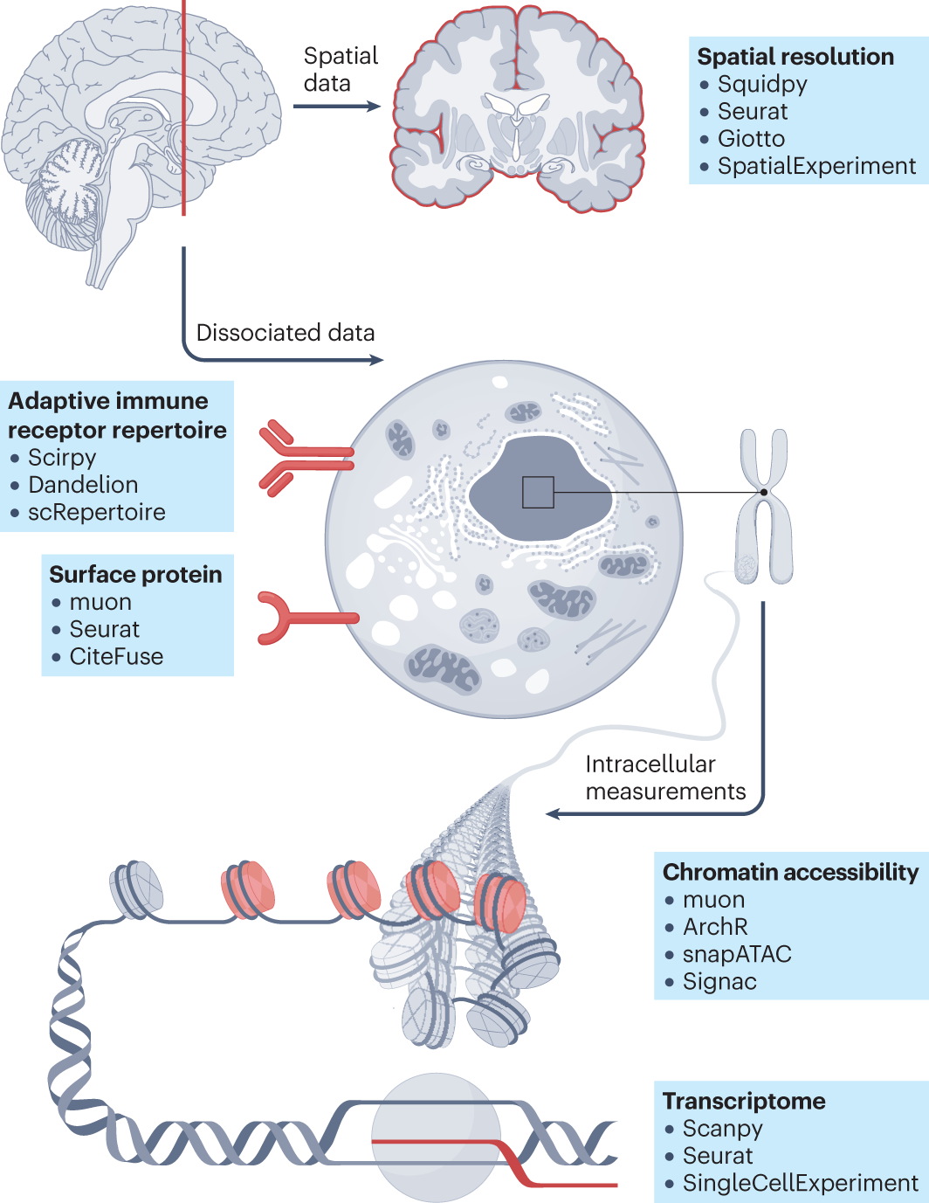
Single-cell ‘omics – single-cell analysis across modalities
from Heumos et al, 2023

Slide 4
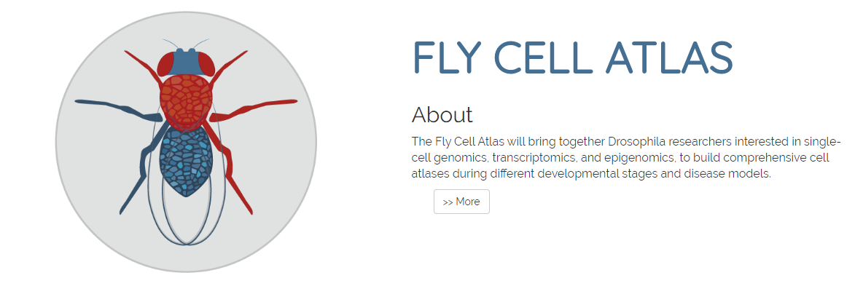

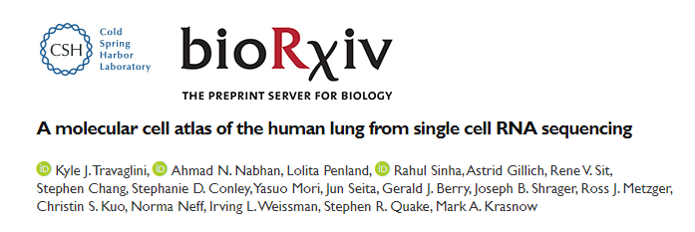

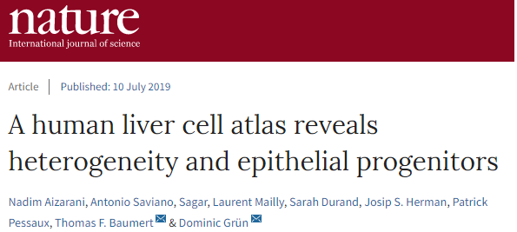
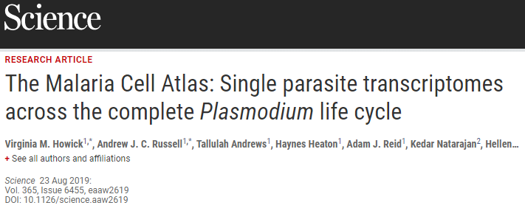
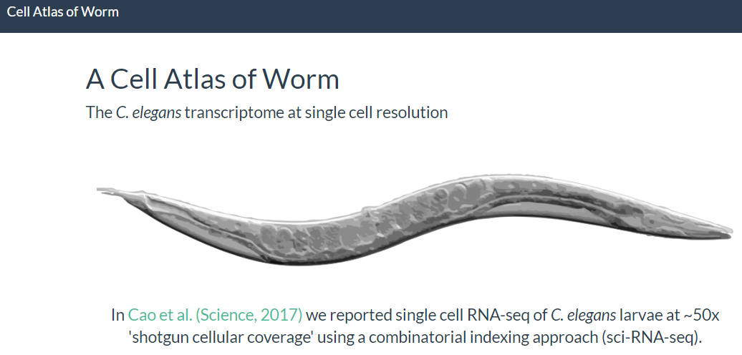
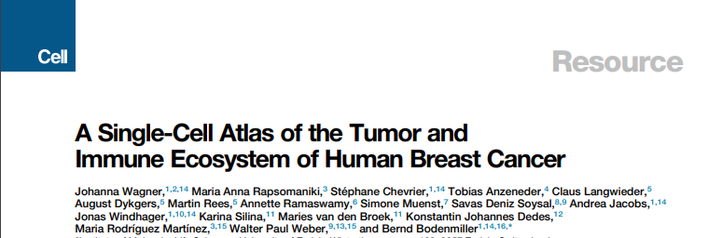
scRNA-seq applications – Creating XXX cell atlases

Slide 5

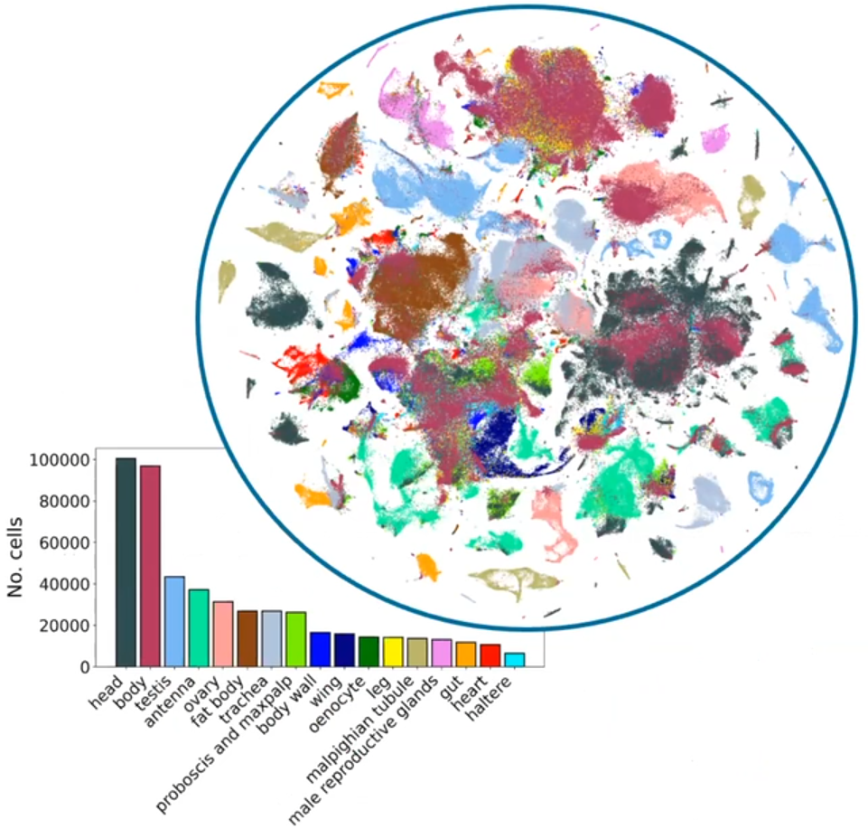


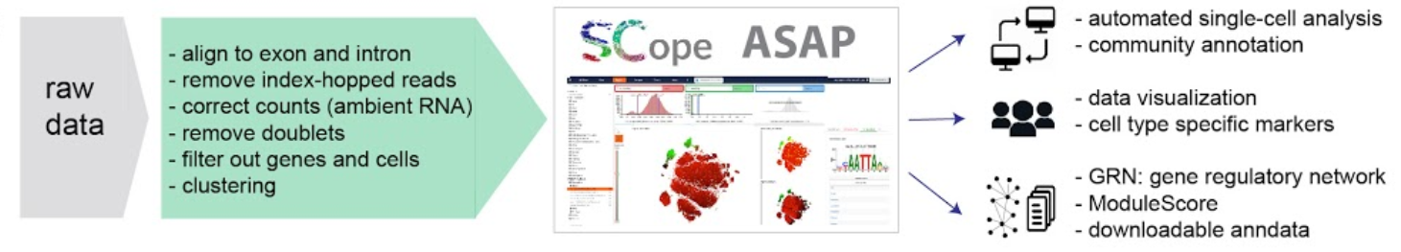

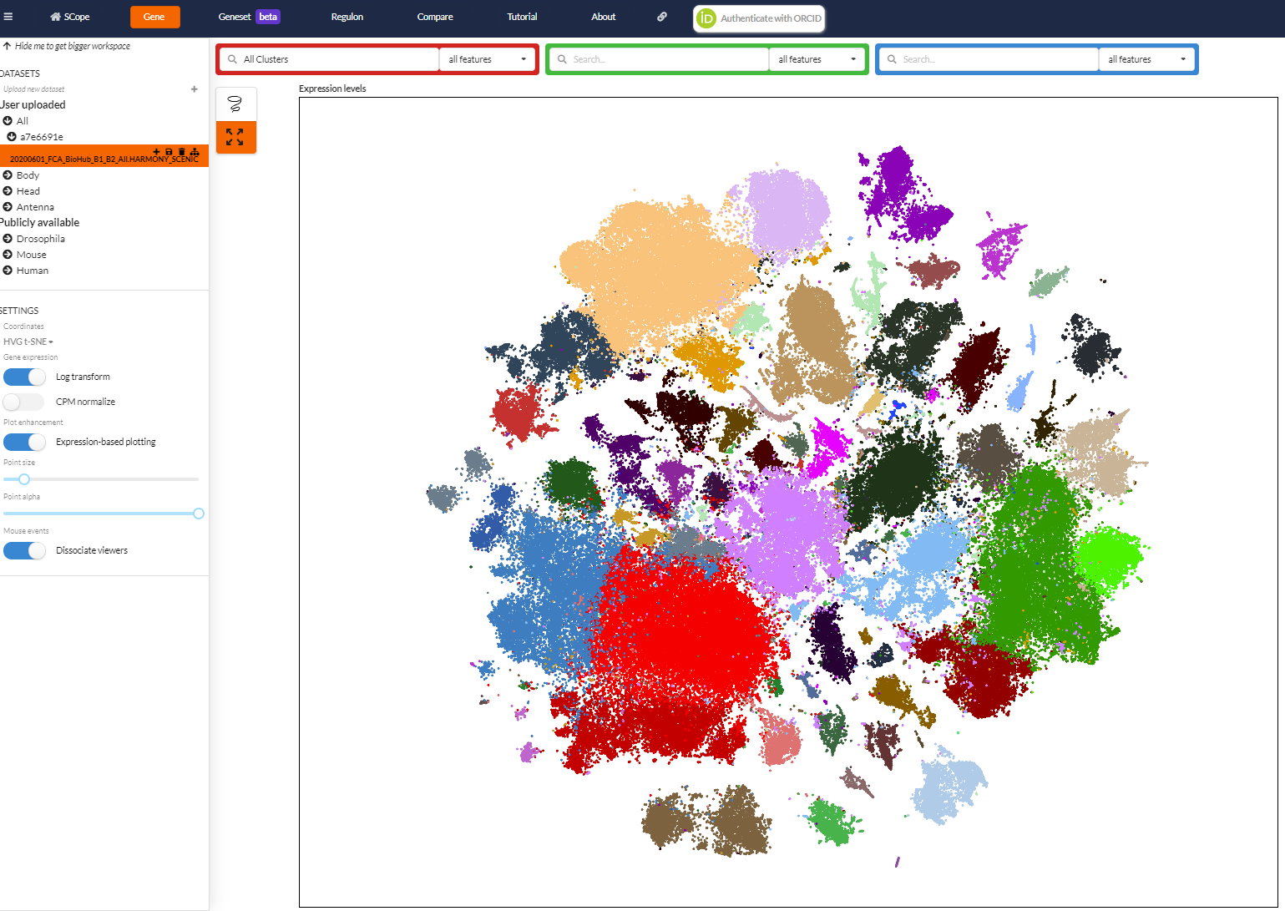
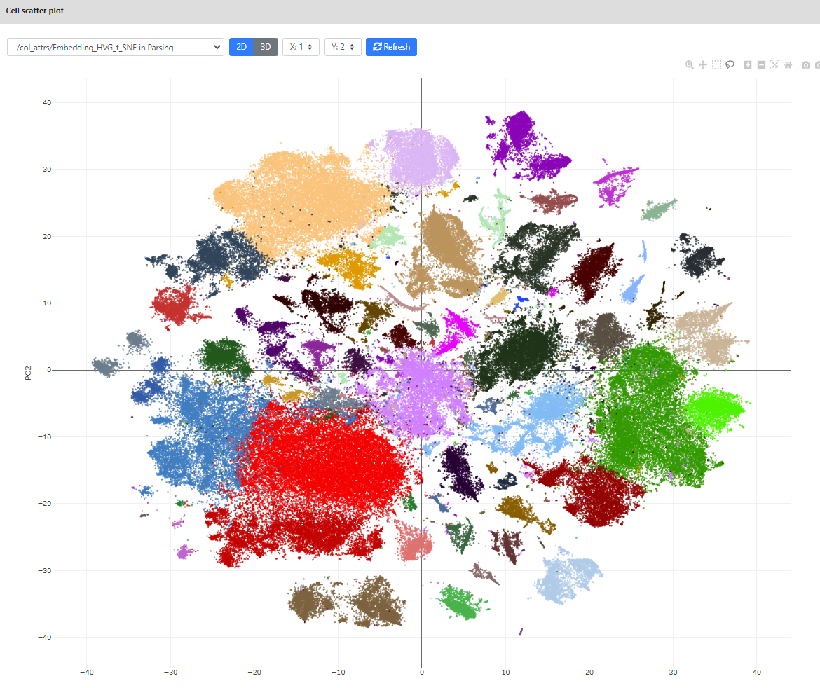

One of the latest atlases: the Fly Cell Atlas
https://flycellatlas.org/
A single-cell RNA-seq atlas of the drosophila melanogaster of 15 tissues, recapitulated in body and head
Data made available through two interactive portals: SCope and ASAP
63 10x runs
38 billion reads
570k cells using 10x
10k cells using SMART-Seq2
And also in
Data exchange
(.loom files, sub-clusters)
https://scope.aertslab.org/
https://asap.epfl.ch/
Li et al., Science, 2022

Slide 6
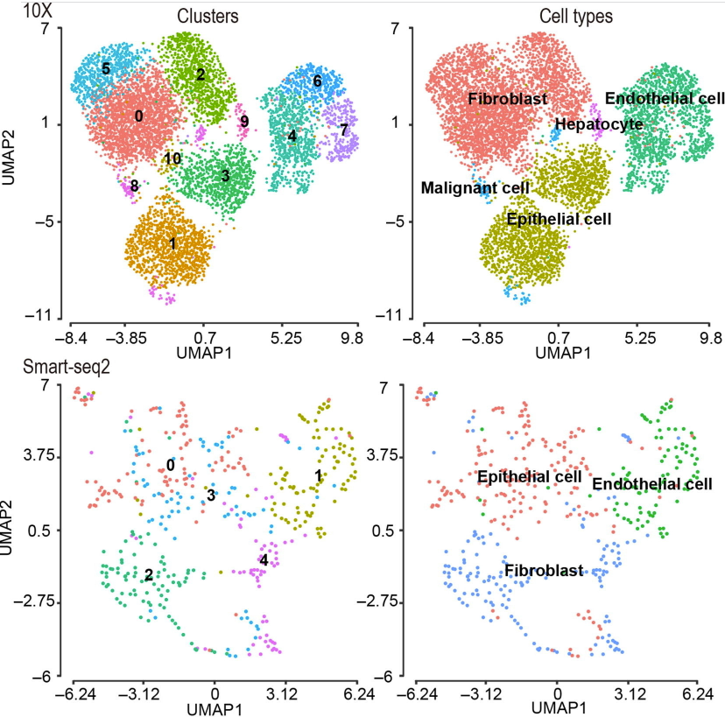
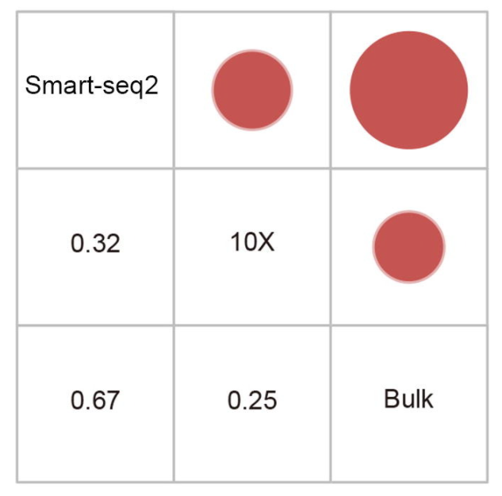
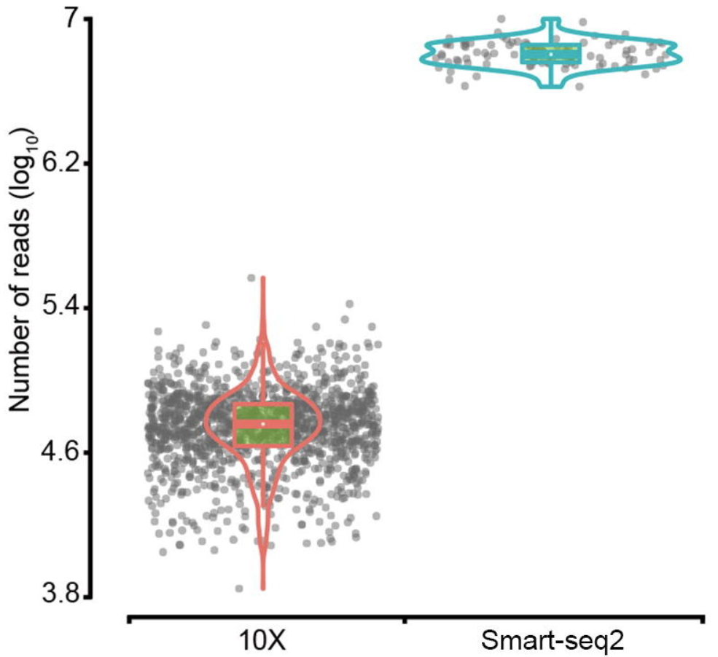
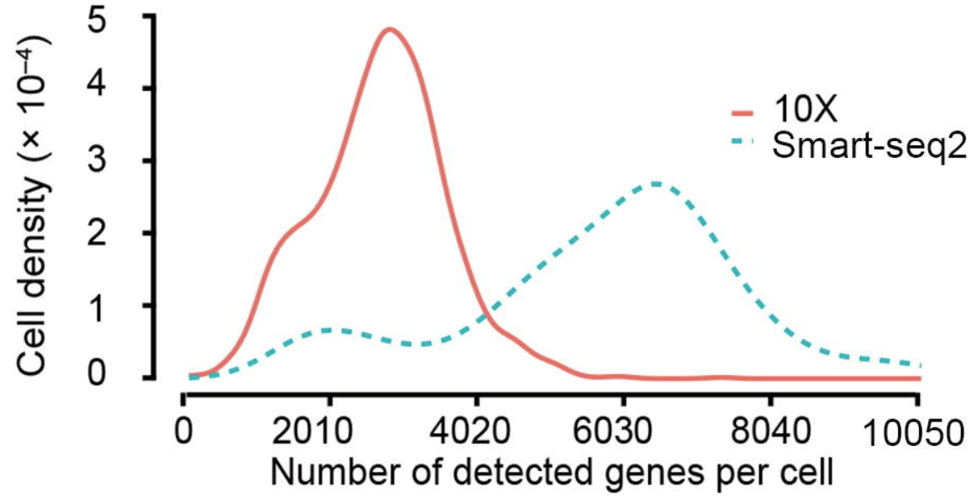
Which protocol to use? Two main protocols currently in use: Smart-seq vs 10x
X. Wang, Y. He, et al, Genomics, Proteomics & Bioinformatics, 2021

Slide 7


Community needs: « I want to do single-cell ! »
I finally got good
single-cell data!!

Slide 8

Community needs: « But how do I analyze single-cell data? »
??
Which tools to use?
R? Python?
Typical bottleneck

Slide 9
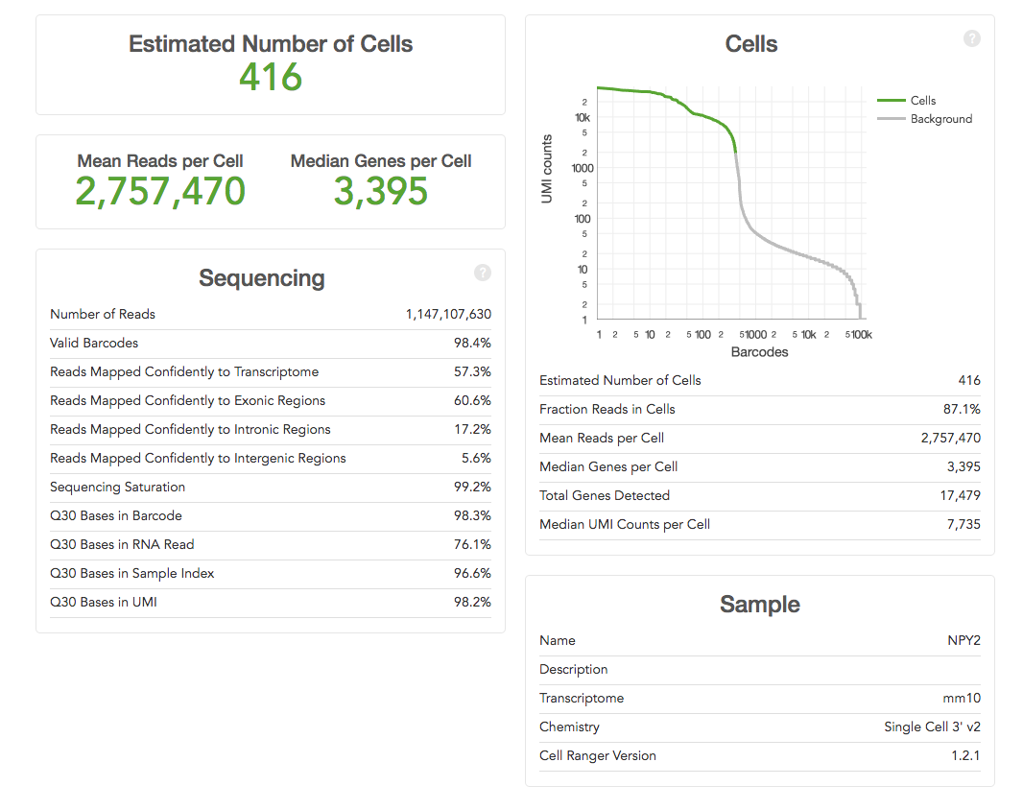


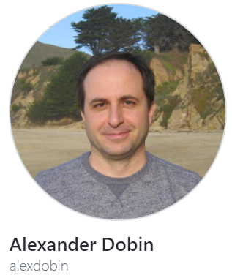




scRNA-seq analysis pipeline
Mapping to reference genome
PREPROCESSING
Demultiplexing & QC
UNIX / bash
Read/transcript matrix
(raw counts/UMI or normalized data)
DOWNSTREAM ANALYSIS
Quality control & filtering (II)
Normalization, noise removal
Study-specific downstream analyses
to generate new biological insight
R / Python
Cell type identification
Cell type characterization
Gene network analysis
Kinetics of transcription

Slide 10
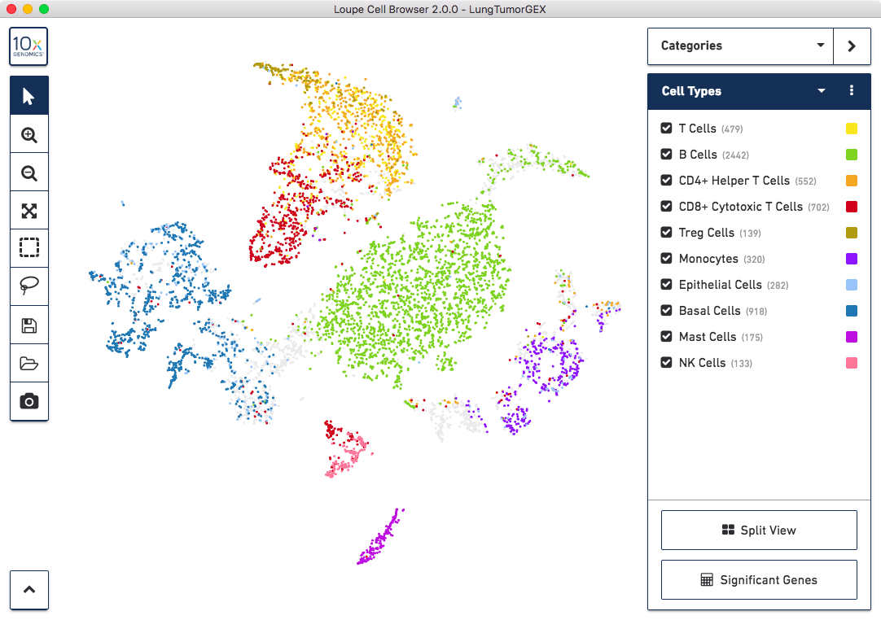
scRNA-seq analysis pipeline
"Black box" fixed pipeline?
e.g. 10x cell Ranger pipeline
+ Loupe Visualization
May be ok for preprocessing.
Usually insufficient for downstream analysis.

Slide 11
scRNA-seq pipeline may not be applicable to all datasets
Solutions
Standardized but parametrizable pipelines (e.g. Seurat, scanpy)
Requires R/Python coding skills. Takes time to implement thoroughly.
User-friendly automated analysis portals (e.g. ASAP, FastGenomics, …)
=> No coding required. Very fast to obtain results. Interactive. Modular. Reproducible.

Slide 12

Single-cell analysis pipelines
Two main pipelines for analyzing single-cell data:
Seurat ( in R ) from Satija lab (2015). Now in v5
SCANPY (in Python) from Theis lab (2018). Now in v1.8

Slide 13
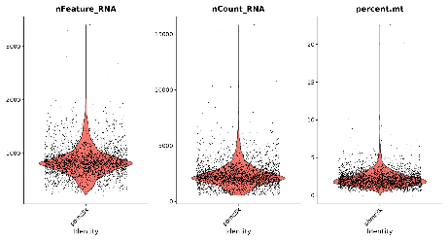
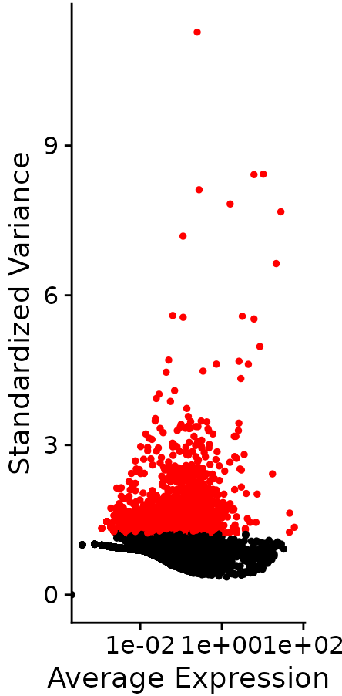
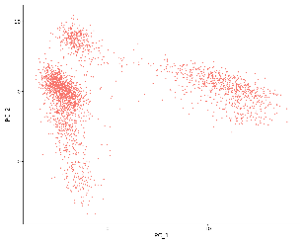
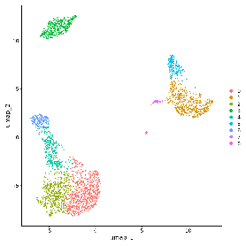
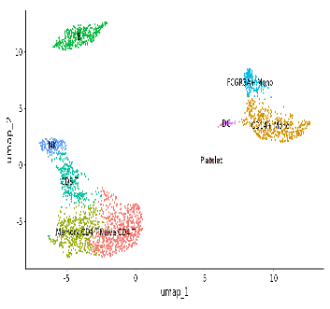
Simplified downstream analysis
QC / Cell filtering
Normalization
Variable features (HVG)
Scaling / Covariate removal
PCA
UMAP
t-SNE
Clustering
Cell-type annotation
DE / Marker genes

Slide 14

ASAP - Automated Single-cell Analysis Portal
ASAP in short:
User-friendly automated single-cell analysis web tool
No coding required. Interactive analysis 100% online.
Very fast to obtain reproducible results (using Docker containers)
Part of the scFAIR initiative for standardizing single-cell genomics data
Technical aspects:
Web page accessible from any computer/tablet with any browser
Common interface designed for reproducible and interactive analysis of data
Centralized computational resources: Ruby-on-Rails server + versioned Python/R/Java code
Job queuing management on server for dispatching client jobs and computing load

Slide 15
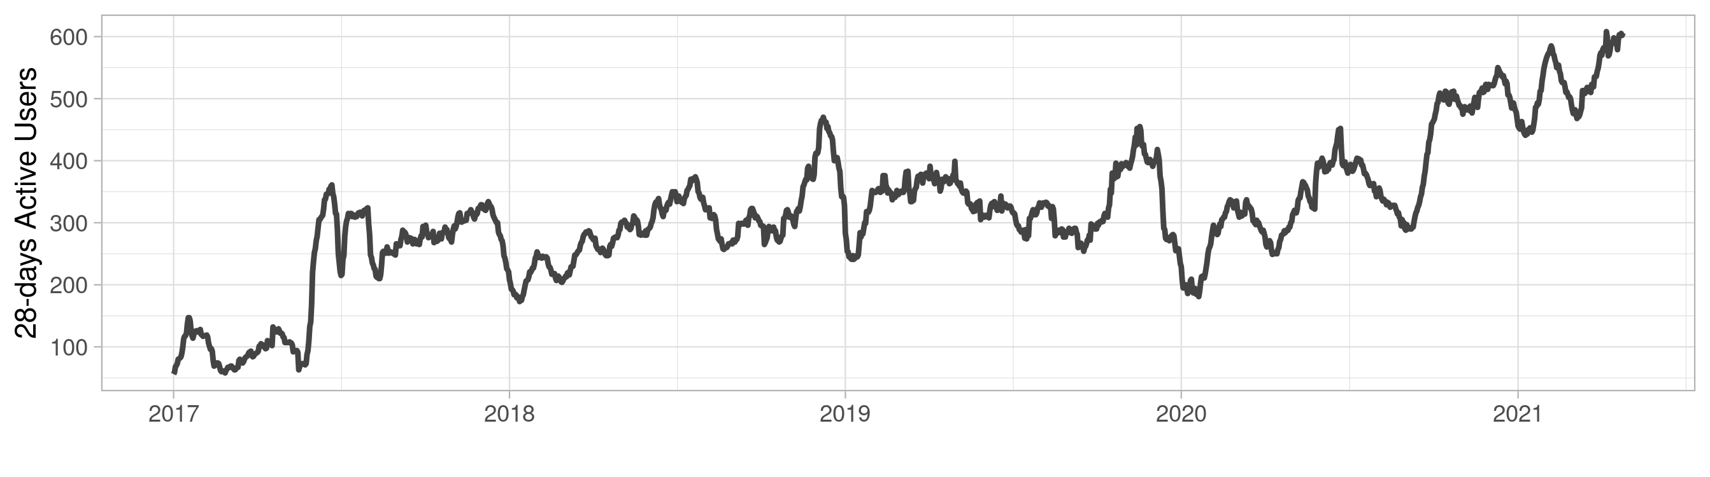
History of ASAP
ASAP2020 Published in Nucleic Acids Research ²
May 2020
ASAP Published in Bioinformatics ¹
Secured 1.5yr funding from EPFL Open Science fund
Inclusion of ASAP in
SIB resource portfolio
May 2017
Cited in Nature single-cell editorial
Fly Cell Atlas kick-off
Jul 2020
Aug 2021
Jun 2017
Mar 2019
FCA workshop at Drosophila Research Conference
Secured 1yr funding from the CZI Biohub (HCA)
CZI Biohub meeting for the
Fly Cell Atlas
Mar 2021
Jan 2018
Aug 2019
Invited talk at the FlyCellAtlas 3 Conference
First release of ASAP
HCA conference San Francisco
Major new release ASAP2020
Jan 2017
Apr 2018
Jan 2020
Apr 2021
2017
2018
2019
2020
2021
Today
¹ Gardeux et al. (2017), Bioinformatics, 33(19), 3123-3125.
² David et al. (2020), Nucleic Acids Research, 48(W1), W403-W414

Slide 16
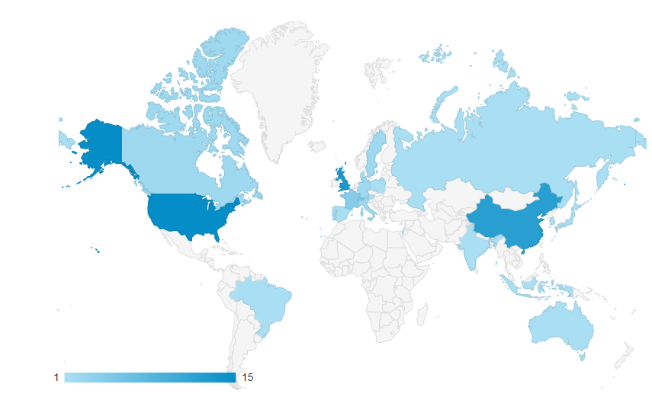
Usage of ASAP
Last 7 days

Slide 17
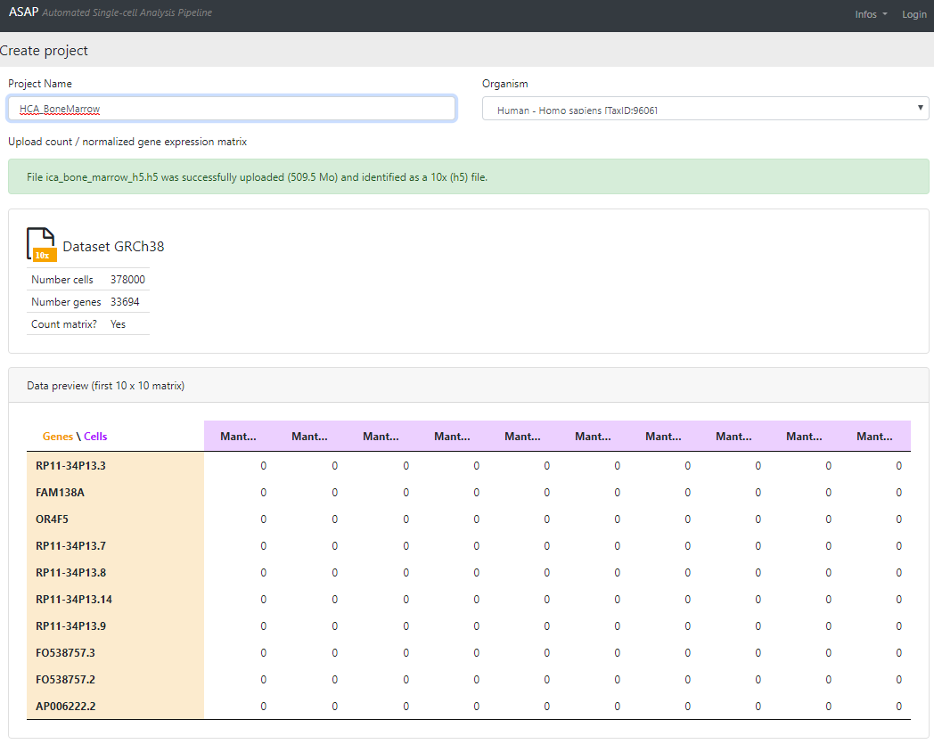
How to use ASAP – 1. Uploading data
Import your own data or load a public project (shared by users or publicly shared such asHCA / FCA)
Handling of TXT, 10x files (output of CellRanger), H5AD, and Loom Format
Can handle ~300 species
Single-cell and bulk RNA-seq pipelines
Automatic transformation in loom/h5ad files
You can also load a pre-analyzed dataset (Seurat / scanpy / …) with all its metadata (for sharing / visualization / crowd annotation)
Limitations:
No spatial transcriptomics (yet)
No scATAC-seq or multiomics (yet)
Integration tool in development

Slide 18
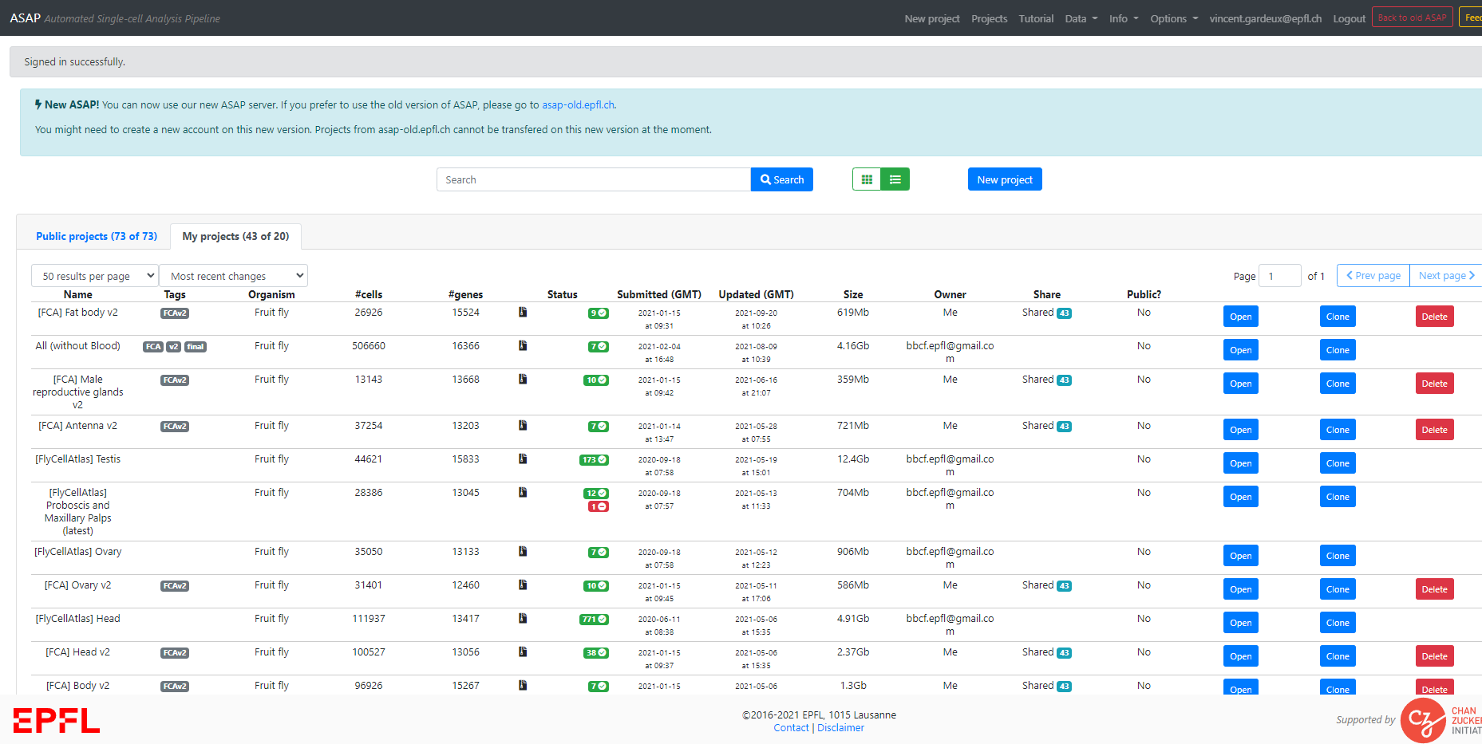
How to use ASAP – 2. Handling ASAP projects
Store and share analyses of single-cell RNA-seq projects
All data is kept fully private by default, but can be set as a public project with a unique permalink URL (for publication)
If not logged in: one sandbox project per session, deleted after 24h
Store all your SC projects in one place
List of publicly available projects
Clone an existing project to perform your own or modify an existing analysis
Sharing feature

Slide 19
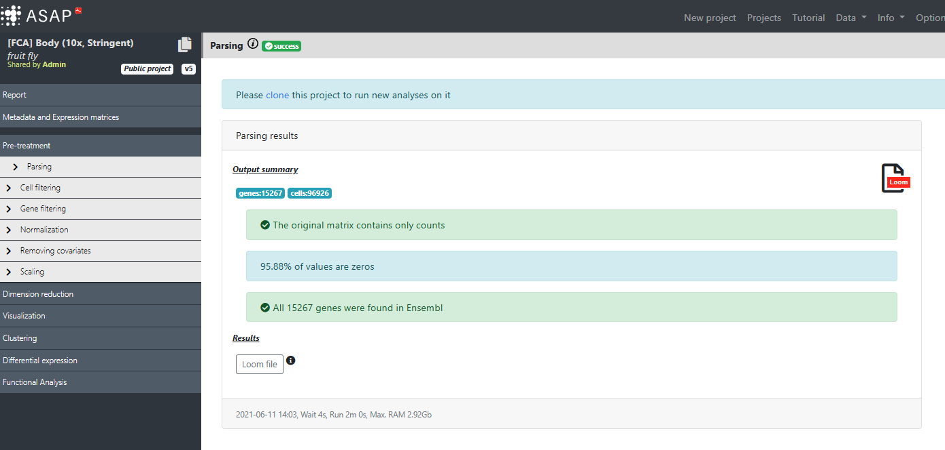
How to use ASAP – 3. Pipeline and visualization tools
Once a project is loaded/cloned, you can run any step of the pipeline
View global project infos, export as loom/h5ad
Check or add new metadata
Steps of the pipeline to check/run (if run within ASAP)
Visualize UMAPs/t-SNEs/PCA… and annotate cell-types

Slide 20
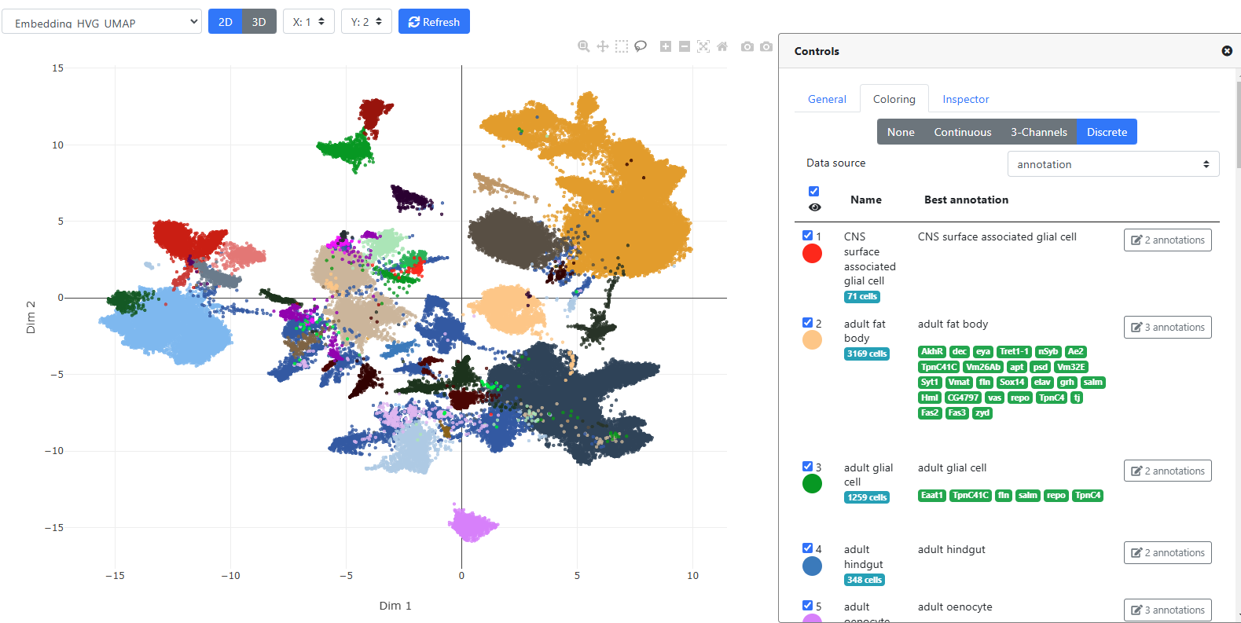
How to use ASAP – 4. Interactive visualization and annotation
Choose embedding to display
Change plot parameters (dot size, …)
Color by continuous metadata (gene expression, depth, %mito, …)
Color by discrete metadata (clustering, annotation, …)
Interactive plot
Annotate clusters / any discrete metadata or upvote/downvote existing annotation
Supporting marker genes for annotation (selected by curator)

Slide 21
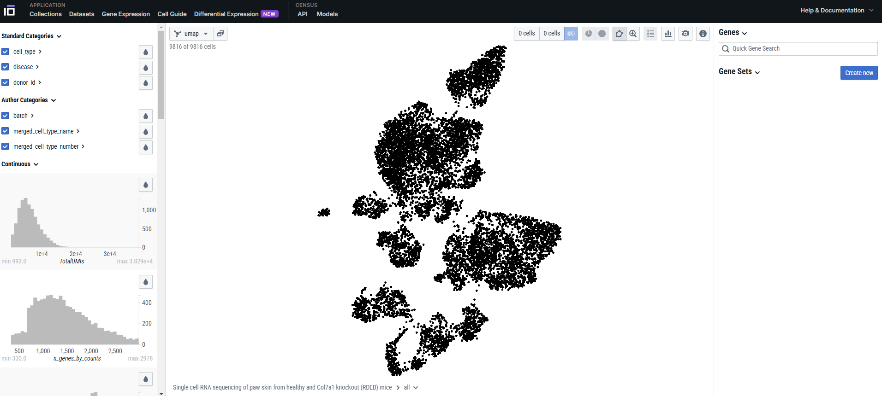
Other visualization-only portals
CELLxGENE (from CZI)
https://cellxgene.cziscience.com/

Slide 22
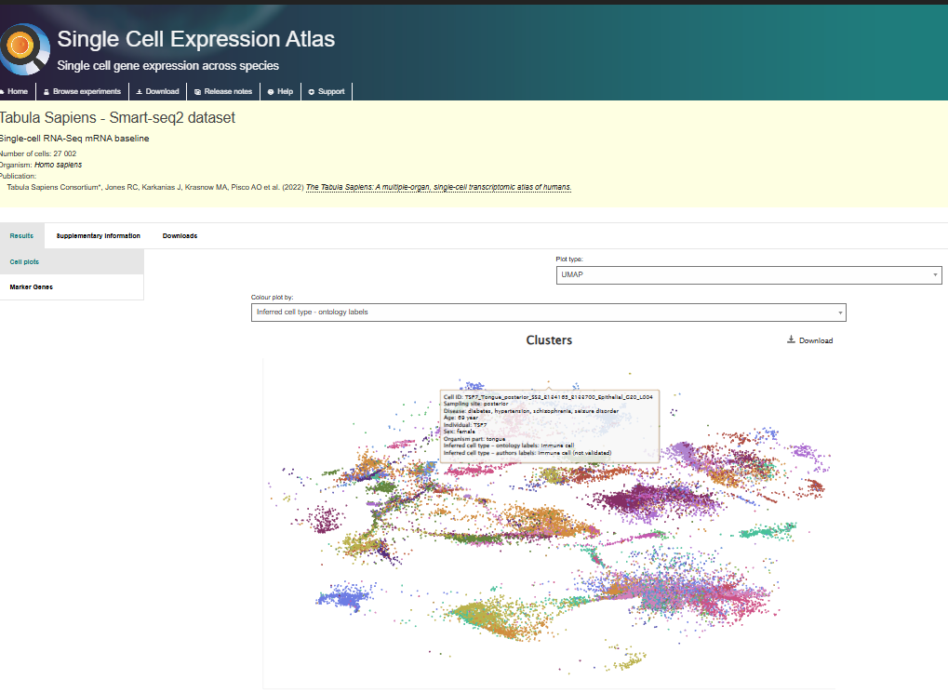
Other visualization-only portals
CELLxGENE (from CZI)
Single-cell Expression Atlas (from EBI)
https://www.ebi.ac.uk/gxa/home

Slide 23
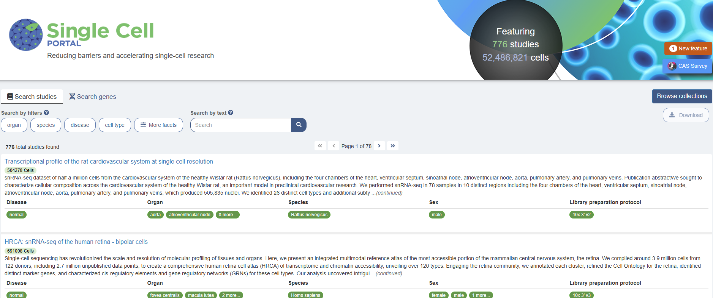
Other visualization-only portals
CELLxGENE (from CZI)
Single Cell Expression Atlas (from EBI)
Single Cell PORTAL (from Broad Instit.)
Bgee (from UNIL)
https://www.ebi.ac.uk/gxa/home
https://singlecell.broadinstitute.org/single_cell

Slide 24
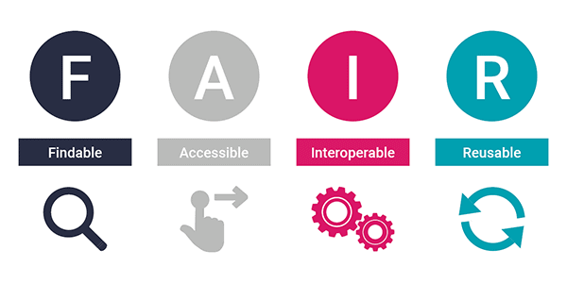

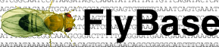

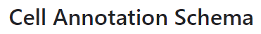


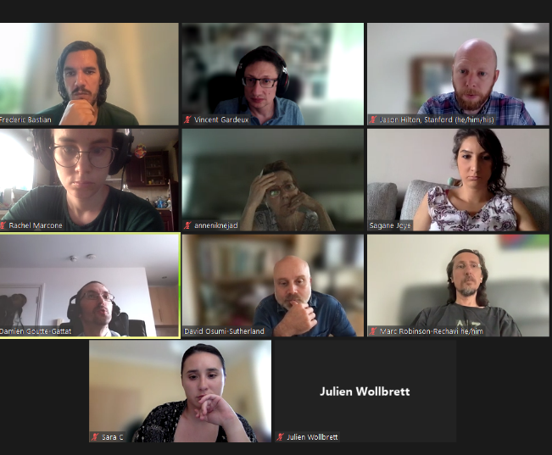
The scFAIR initiative in short
Consortium for the adoption of FAIR practice and the development of standards for scRNA-seq datasets (scfair.slack.com)
Comes from a global understanding that there was a need for harmonizing single-cell data and metadata
FAIR ≠ drop site
Define standards with ontology, curators and single-cell experts
Define metadata schema for single-cell datasets
Ontologies and controlled vocabularies to use (e.g. for cell-type, tissue, dev. stage)
Exchange platform, tools, pipeline metadata

Slide 25
The scFAIR initiative in short
Consortium for the adoption of FAIR practice and the development of standards for scRNA-seq datasets (scfair.slack.com)
Comes from a global understanding that there was a need for harmonizing single-cell data and metadata
FAIR ≠ drop site
Define standards with ontology, curators and single-cell experts
Define metadata schema for single-cell datasets
Ontologies and controlled vocabularies to use (e.g. for cell-type, tissue, dev. stage)
Exchange platform, tools, pipeline metadata

Slide 26
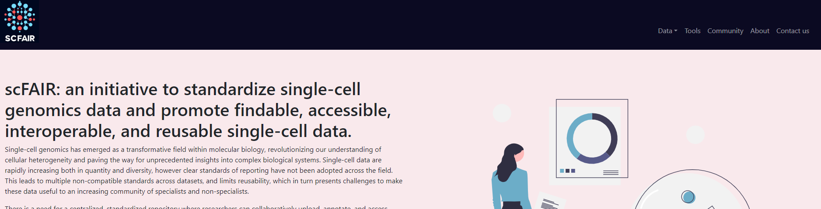
scFAIR web page
We are developing a web tool for summarizing our work and accessing different datasets from multiple portals already participating in this dataset standardization effort (currently ASAP, Bgee and CELLxGENE)
https://sc-fair.org

Slide 27

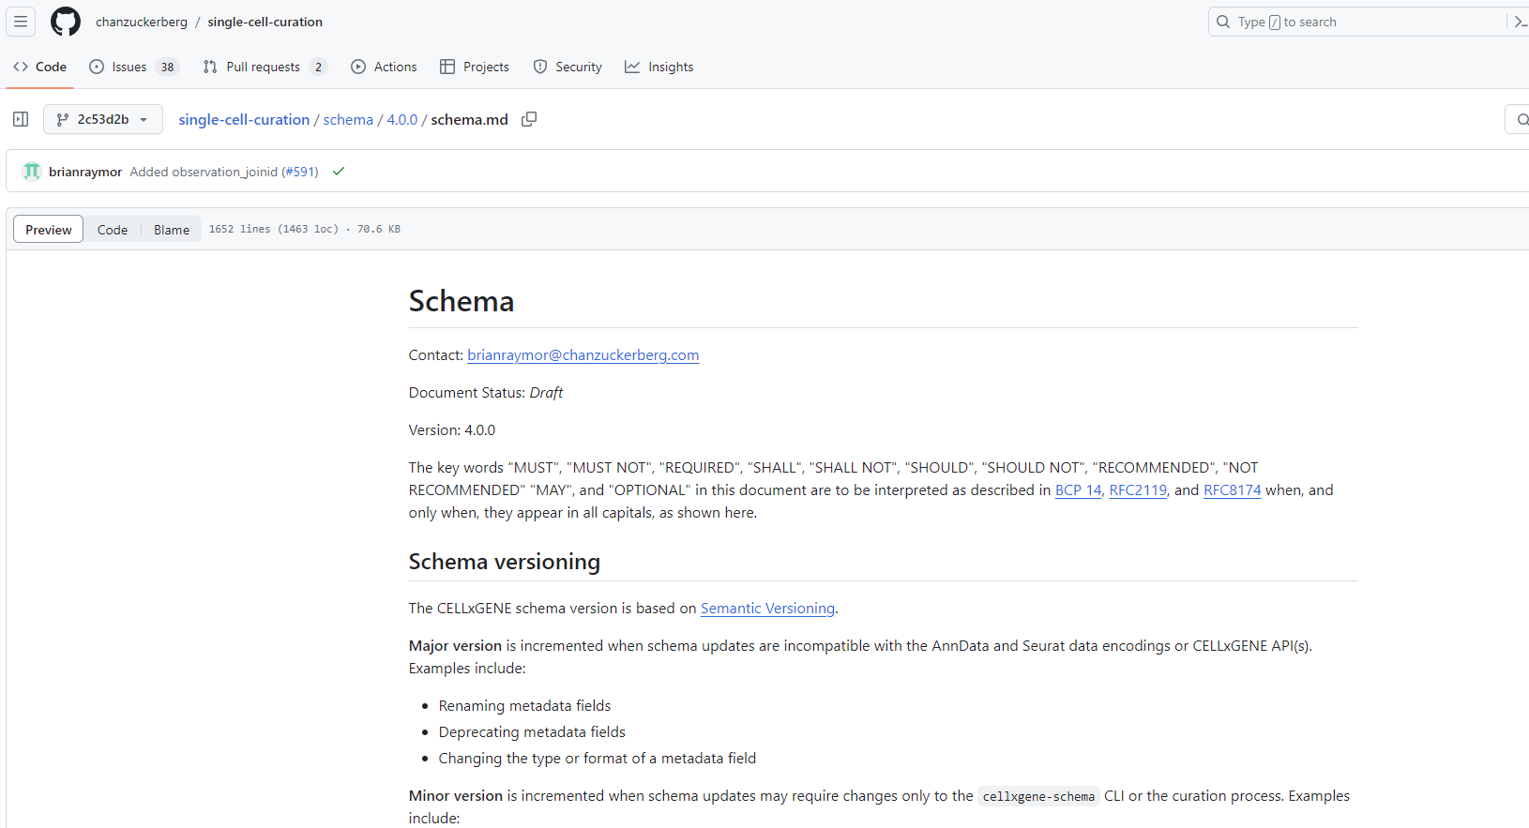
scFAIR objectives
We are collaborating with the CELLxGENE team
Defined a schema (current v5.1.0) for uploading single-cell datasets as h5ad
Created a validator for h5ad files, to check they meet the schema requirements
Limitations:
Currently mostly limited to Human and Mouse
No curation of the annotation provided by the users (used as-is)
No information on the pipeline used (tools, parameters, annotation strategy)

Slide 28


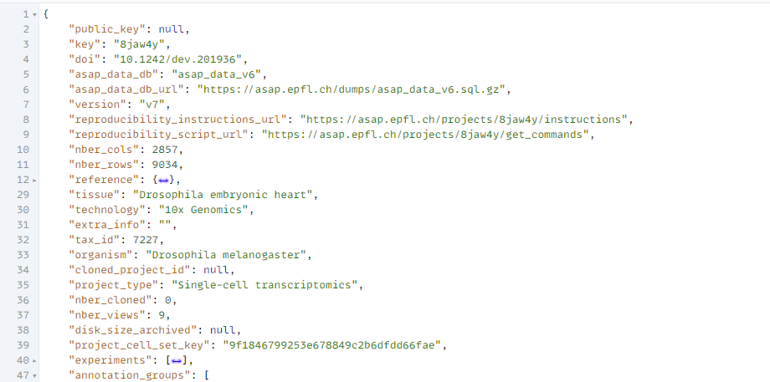

scFAIR achievements
We are extending the CELLxGENE schema including:
Broader definition of species/cell-types/tissues using the composite/collective-metazoan ontology (for not being restricted to human/mouse ontologies)
to comply to the “composite metazoan” cell-type/tissue ontology
Upgraded as 5.1.0-broad
Adding the pipeline/marker gene information, probably as a JSON directly in the /uns path of the h5ad file
We already do that in ASAP as a JSON file. Store in under uns/ in h5ad file
Forking the validator from CELLxGENE to validate a h5ad file to this new schema

Slide 29
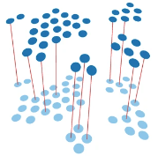
Future developments in ASAP
We are currently adding an integration tool for integrating ASAP projects
We will make all projects exportable in a scFAIR-compliant schema format
We will add more public projects available directly in ASAP
We will simplify the visualization UI, especially for annotation / coloring
Image from Heumos et al, 2023

Slide 30


Thanks
SIB 2024 course – Using ASAP for Single-Cell Analysis
Vincent Gardeux

